Slide 1
Testing with Serialization Deserialization

Slide 2
Suppose you want to save your data
Common problem:
You’ve built a large, complex object
Has multiple state info
Lots of data
Want to store on disk and retrieve later
For large data, you would use a database
What if you don’t want/need to use a DB?

Slide 3
Option 1) Custom file formats
Save to a file
Write a set of methods for saving/loading each class that you care about

Slide 4
Benefits of Option 1
Can produce arbitrary file formats
Know exactly what you want to store and get back/don’t store extraneous stuff
Can build file formats to interface w/ other codes/programs
XML
Tab-delimited, comma-delimited
Etc.

Slide 5
Disadvantages of Option 1
Have to write custom code on how to save/load
If all you want to do is store/retrieve data, do you really need to go to all of that effort?
Fortunately, Java provides a shortcut that takes a lot of the work out.

Slide 6
Option 2) Serialization
Java provides the serialization mechanism for object persistence
It essentially automates the grunt work for you

Slide 7
Serializing Objects
Convert objects to a byte sequence
Called “serialization”
Object can be represented as a sequence of bytes that includes the object's data as well as information about the object's type and the types of data stored in the object.
Serialized object is written into a file
Read from file and convert from byte-sequence back to object
Called “deserialization”
bytes that represent the object and its data can be used to recreate the object in memory

Slide 8
When to Use Serialization?
Two main scenarios for object serialization:
1. Saving object state to persistent storage
Convert object into a byte-sequence, then save it to a file
Later, read byte-sequence from file and recreate the object
2. Sending an object to another JVM or computer
Convert object to byte-sequence, then send byte-sequence to the other JVM
Other JVM converts byte-sequence back into the object

Slide 9
In more detail
To (de-)serialize an object, it must implements Serializable
All of its data members must also be marked serializable
Primitive types (int, char, etc.) are all serizable automatically
So are Strings, most classes in java.util, etc.

Slide 10
Java Serialization
Provided by two stream implementations:
java.io.ObjectOutputStream
public void writeObject(Object obj)
Among other capabilities, converts an object to a byte-sequence describing both type and state details "
java.io.ObjectInputStream
public Object readObject()
Converts a byte-sequence back into an object, using type and state data in the byte-stream

Slide 11
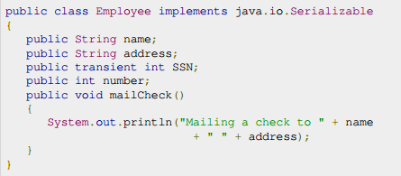
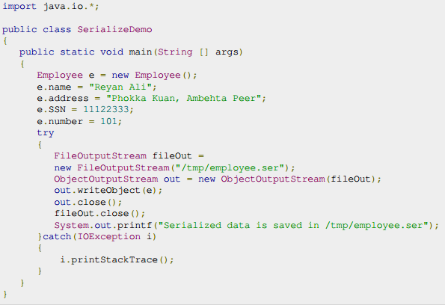
Example

Slide 12

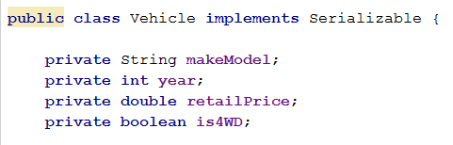
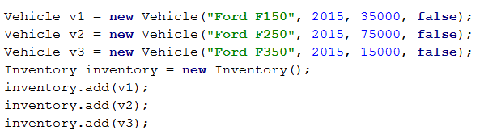
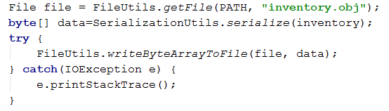
Example Using SerializationUtils – Apache Commons Lang

Slide 13
inventory.obj

Slide 14
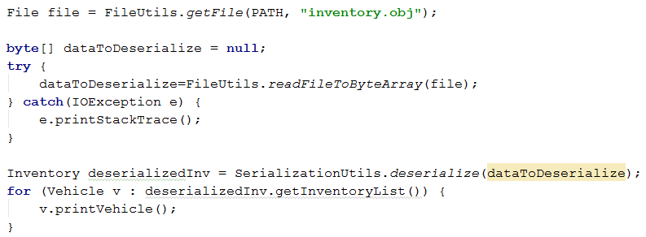
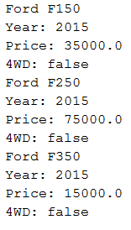
Deserialization

Slide 15
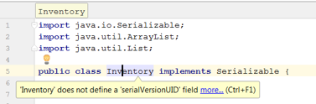
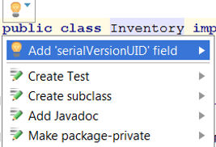

Serial Version UIDs

Slide 16
Serial Version UIDs
Java assigns a “serial version UID” to your class, based on its fields and field-types
Version ID is stored with object in output-stream data
If class changes, serial version UID also changes
Deserializer reports an error if data-stream’s serial version UID doesn’t match the class’ current version UID

Slide 17
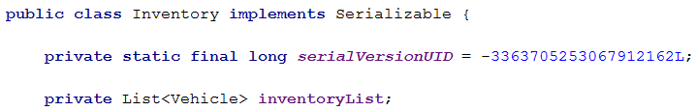
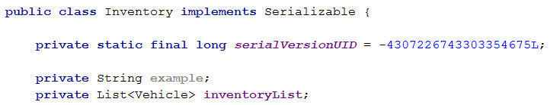
Serial Version UIDs
Suppose you serialized your object with this class.
Then you updated your class to include an extra field.

Slide 18
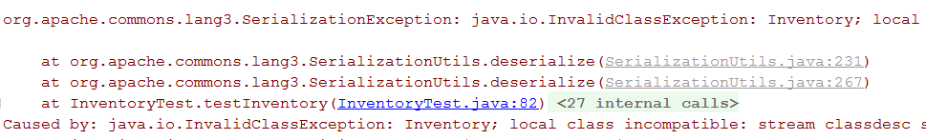
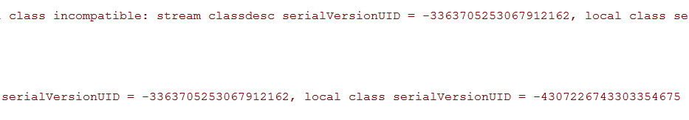
Serial Version UIDs
With the updated code, if you try to deserialize the OLD serialized object (previous version)

Slide 19
Using Java Serialization Reminders
Not all objects can be serialized
Only ones that implement java.io.Serializable
Many Java collections, arrays, etc., are serializable
Serializable is a tag interface
Specifies whether a class can be serialized or not

Slide 20
Using Java Serialization Reminders
Serializable objects must contain serializable data
All primitive types are serializable
Any object fields must also be of a serializable type
Ex) Arrays are serializable if all elements are serializable
Most collection classes in java.util are serializable
If an object (or its contents) isn’t serializable: A NotSerializableException is thrown

Slide 21
Test suites
You can define a suite of tests
@RunWith(value=Suite.class) @SuiteClasses(value={ MyProgramTest.class, AnotherTest.class, YetAnotherTest.class }) public class AllTests { }

Slide 22
Test suites
test suite: One class that runs many JUnit tests.
An easy way to run all of your app's tests at once.
import org.junit.runner.*;
import org.junit.runners.*;
@RunWith(Suite.class)
@Suite.SuiteClasses({
TestCaseName.class,
TestCaseName.class,
...
TestCaseName.class,
})
public class name {}

Slide 23
In conclusion
Test one thing at a time per test method.
10 small tests are much better than 1 test 10x as large.
Each test method should have few (likely 1) assert statements.
If you assert many things, the first that fails stops the test.
You won't know whether a later assertion would have failed.
Tests should avoid logic.
minimize if/else, loops, switch, etc.
avoid try/catch
If it's supposed to throw, use expected= ... if not, let JUnit catch it.
Complex tests are okay, but only in addition to simple tests.

